Slide 1
Build sophisticated stateful assistants faster
Augment your copilot to access multiple APIs
Assistants API
Perform complex computations and data analysis
Safely act on the user’s behalf
Retrieve useful data in multiple formats*
Notes:
Purpose-built AI that uses Azure OpenAI Service’s models and calls tools to perform complex tasks
Why
Introduce state-fulness to copilots easily: Build powerful, stateful Copilot and agent-like experiences through a single API
Reduced development effort: No need for multiple integrations to manage state, context windows and chat threads, retrieval, code execution and external extensions
Powerful native tools and 3P extensibility: Enable developer access to powerful in-built tools in parallel such as code interpreter and knowledge retrieval and external extensions through function calling
Enable groundbreaking virtual multi-agent scenarios: Envision virtual agent workforces that not only community with each other but also execute tasks to enable end to end flows with the right security guardrails

Slide 2
Assistants Stack
Apps
Microsoft Copilot Extensibility
Microsoft Copilots
+ your copilots
Copilots
AI orchestration
Instructions (Meta Prompt)
Built-in safety system
and responsible AI
tools
Function Calling
Assistant
Tools
Code Interpreter
Azure OpenAI
Assistants API
Knowledge Retrieval
Foundation models
AI infrastructure

Slide 3
Assistants API
Why
Introduce state-fulness to copilots easily: Build powerful, stateful Copilot and agent-like experiences through a single API
Reduced development effort: No need for multiple integrations to manage state, context windows and chat threads, retrieval, code execution and external extensions
Powerful native tools and 3P extensibility: Enable developer access to powerful in-built tools in parallel such as code interpreter, knowledge retrieval* and external extensions through function calling

Slide 4
Chat Completions API vs. Assistants API
Chat Completions API
Lightweight and powerful
Inherently Stateless
Assistants API
Stateful (inbuilt conversation state management)
Access persistent Threads
Access files in several formats. API handles chunking, embeddings storage and creation, and implementing vector search*
Automatic management of the model’s context window
Access multiple tools in parallel ( up to 128 tools per Assistant) incl Code Interpreter
Build your own tools using Function Calling

Slide 5
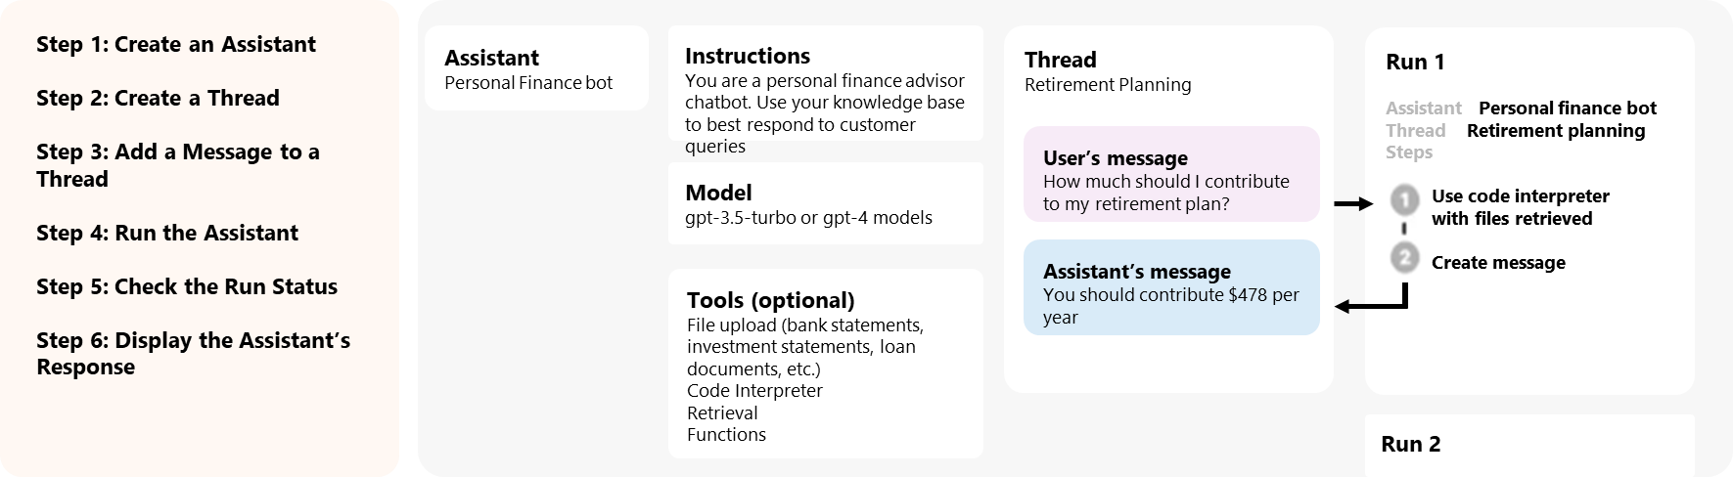
How Assistants Work
Assistants
Notes:
bing seach, cog search, Azure SQL, Azure CosmosDB, Azure Translator

Slide 6







Example Scenario: Travel app powered by Assistants API
Vertical: Travel; Domain: Customer Service; Objective: Improve time to response, delight users
1
Participants
2
Tools showcased
1. Code Interpreter
2. Knowledge Retrieval*
3. Function Calling (integration with multiple APIs)
Customer
(needs travel planning and booking help)
Assistant 1:
Travel Consultant
(User proxy agent)
TBC: Assistant 2:
Booking Agent
(Specialized agent)
Deutsche Bahn API
(live train schedules)
Graph API or Logic Apps
(read/write to Outlook)
Solves complex math problems and advanced data analysis
RAG over user docs
(1) flight_itinerary.txt (2) Airbnb_bills.pdf (3) train_ids.csv
(4) stations.csv
3
4
Assistant Setup
Multi-Assistant Thread Runs with parallel function calls
Pick a model (gpt-4-1106-preview)
Define custom instructions for each Assistant: “You’re a travel consultant providing…”, “You are a train booking agent…”
Activate retrieval and Code Interpreter tools
Add files
Add functions: e.g. get_journey, get_actual_datetime, get_bestprices
User uploads flight itinerary and asks: “Suggest a day-by-day itinerary for the dates of my travel”
Assistant retrieves the files and then answers the question
User asks “Block my calendar for the dates of Oktoberfest”
Assistant looks up itinerary for music festival date and calls Microsoft Graph API to create outlook event in user calendar
User uploads their Airbnb bills and asks : “We'll be 4 friends staying at this Airbnb in Berlin. What's my share of costs + my flight?“
Assistant calls Code Interpreter to generate Python code and then answers question.
User asks “Give me the cheapest connections from Berlin to Munich the week of Oct 27th
Assistant calls DB API for train routes and ticket prices and displays them
Notes:
An Assistant has instructions and can leverage models, tools, and knowledge to respond to user queries. The Assistants API currently supports three types of tools: Code Interpreter, Retrieval, and Function calling.
What are some exciting scenarios for assistants? Found three key use cases, mostly leaning towards autonomous agents and often multi-agent scenarios. But there are three use case that autonomous agents seems great for:
Independent research
Finding and creating stuff and coming to a conclusion e.g. from google when browsing
Changing things together and creating questions to generate answers
With this demo, we will creating a customizable controllable AI system for a travel app powered by the Assistants API that is usable in production
- Multi-Assistant Thread Runs: We have two assistants using the same thread, One is a travel consultant and the other a booking agent. A1 will acts as a facilitator for other agents and ensure smooth communication. The current system does not support conversations between the agents executing tasks, which improves overall steerability but can be adjusted by adding more threads into the agent_and_threads object.
- Runs execute asynchronously, requiring continuous checking for updates until the run is finished, adding complexity to the process of retrieving the final assistant response.
- Parallel Function Calls: calling multiple tools and APIs in a single Step
- The user proxy agent acts as sort of a load balancer, distributing requests to specialized individual agents and converses with them until the task is executed, allowing for a natural conversation flow and the ability to perform tasks such as retrieving train routes and best prices

Slide 7
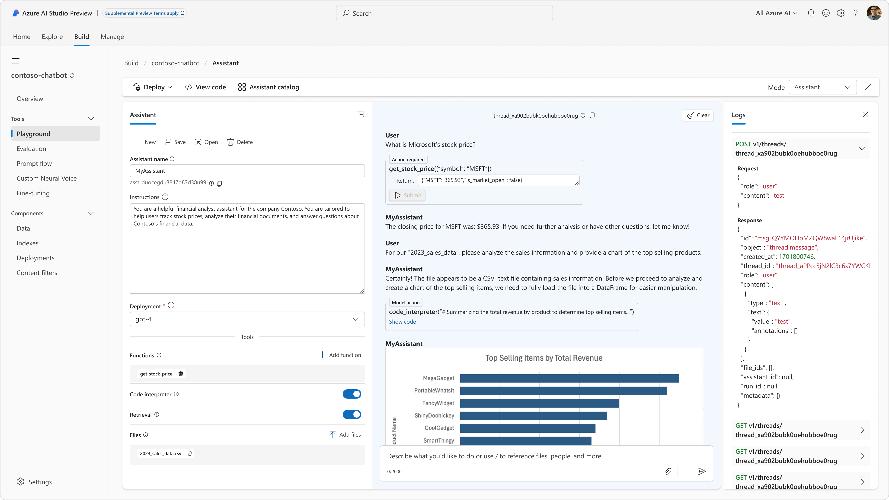
Start building with Assistants today
https://aka.ms/AOAIAssistants

